Slide 1
Introduction to Compiler Design
Chapter-1 (Keith Cooper)
Materials from COMP412, 2017 of Prof Keith Cooper modified by
Nalinadevi Kadiresan, CSE DEPT.
AMRITA SCHOOL OF ENGG.

Slide 2


Compiler and Interpreter ?
Compilers are computer programs that translate a program written in one language into a program written in another language.
Interpreters are programs that reads an executable program and produces the results of executing that program
+ input data
Even Semester 2017-18
Nalinadevi Kadiresan

Slide 3
Compiler and Interpreter ?
C and C++ are typically compiled
Python & Scheme are typically interpreted
Any language can be interpreted or compiled
Java is complicated
  – compiled to bytecode (code for the Java VM )
  – which are then interpreted
  – or a hybrid strategy is used
  ➝ Just-in-time compilation
Building internal model and value storage is similar for Compiler and Interpreter except for output form
Even Semester 2017-18
Nalinadevi Kadiresan

Slide 4
High Level language to Machine Language
One PL to many Machine instruction
Instruction-1
Statement-1
Instruction-2
.
.
.
Programming languages have strict syntax and semantics
Instruction-n
Even Semester 2017-18
Nalinadevi Kadiresan

Slide 5
Objectives of CD
The compiler must preserve the meaning of the program being compiled.
The compiler must improve the input program in some discernible way.
Even Semester 2017-18
Nalinadevi Kadiresan

Slide 6
Types of output generated
Compilers may generate three types of code:
  Some other high level language (than source)
    Like the generation of C program from UML specs, PDF from source document forms.etc.,
  Pure Machine Code
    Machine instruction set without assuming the existence of any operating system or library.
    Mostly being OS or embedded applications.
  Augmented Machine Code
    Code with OS routines and runtime support routines.
    More often
  Virtual Machine Code
    Virtual instructions, can be run on any architecture with a virtual machine interpreter or a just-in-time compiler. Ex. Java
Even Semester 2017-18
Nalinadevi Kadiresan

Slide 7
Types of Machine language generated
Another way that compilers differ from one another is in the format of the target machine code they generate:
  Assembly or other source format
  Re-locatable binary
    Relative address
    A linkage step is required
  Absolute binary
    Absolute address
    Can be executed directly
Even Semester 2017-18
Nalinadevi Kadiresan

Slide 8
Compiler is not a old concepts
Internet application
Embedded Systems
Gaming
Social Networks
Super Computers
Builds virtual tools on top of hardware abstractions that needs translation
Even Semester 2017-18
Nalinadevi Kadiresan

Slide 9
Understanding how compilers work, can help in many other areas
If you are building a server that must grow to billions of transactions per hour, use an efficient, compiled language (e.g., not PHP)
If you are building a commercial operating system, use a base language and runtime that checks for string overflow (e.g., not ANSI C)
If you are writing long-running code, use a language with a managed runtime (i.e., automatic storage reclamation) and use leak-detecting tools
If you need to meet real-time deadlines, use malloc() and free(), along with leak-detecting tools
Even Semester 2017-18
Nalinadevi Kadiresan

Slide 10
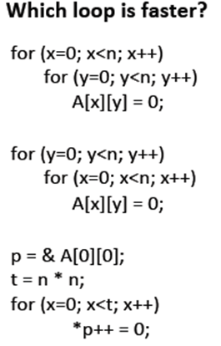
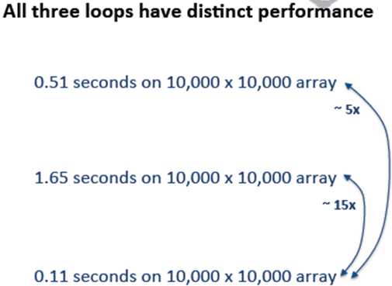
Performance enhancement- space vs time tradeoff
Based on the wisdom best thread safe option is bzero, memset
Even Semester 2017-18
Nalinadevi Kadiresan

Slide 11
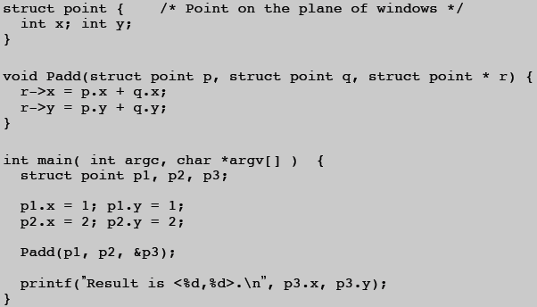
Assignment-1
Run this with gcc –O1, O2 and O3 levels and with –s option
  explain the output in without optimization and with different levels of optimization
  Modify the int with short and check the performance
  Make Padd a macro and check the performance
  Make Padd method static and check the performance
Even Semester 2017-18
Nalinadevi Kadiresan

Slide 12
Why is Compiler construction Challenging???
Abstraction –PL and IR
Multiple Solutions – too many algorithms
Can be formulated as discrete optimization problem, hence NP Problem
Even Semester 2017-18
Nalinadevi Kadiresan

Slide 13
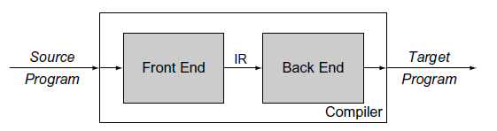
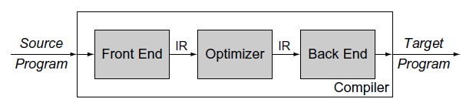
Compiler Structure
Analysis and Synthesis
Avoids Retargeting
Effort m*n reduces to m+n
Performance enhancement
****The task of changing the compiler to generate code for a new processor is often called retargeting the compiler.
Even Semester 2017-18
Nalinadevi Kadiresan

Slide 14

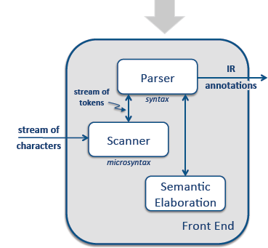
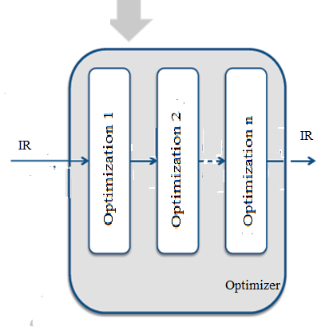
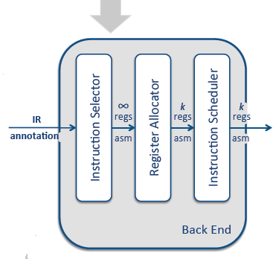
Overview of Translation
Even Semester 2017-18
Nalinadevi Kadiresan

Slide 15
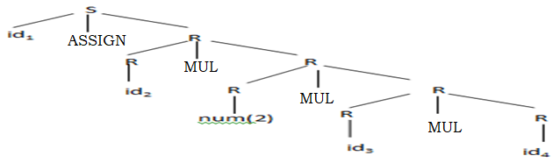
Stream of Characters
a←a * 2 * b * c * d
RE
ASSIGN : ‘←’
MUL : ‘*’
ID : [a..z][a..z0..9 _]*
NUM : [0..9]+
Scanner
[Lexical Analyzer]
Stream of Tokens
<id,a>← <id,a> * <num,2> * <id,b> * <id,c> * <id,d>
Concrete Parse tree( CPT/ CST)
Parser
[Syntax Analyzer]
CFG
S → ID ASSIGN R
R → R MUL R
R → ID
R→ NUM
Even Semester 2017-18
Nalinadevi Kadiresan

Slide 16
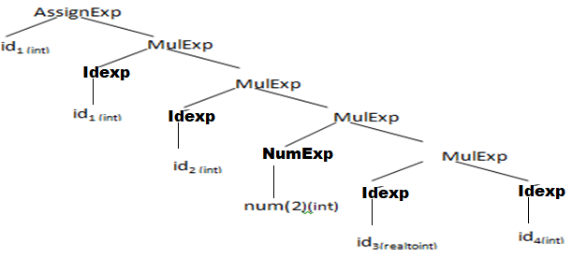
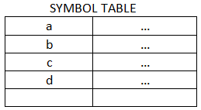
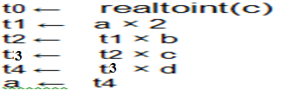
CFG
S → ID ASSIGN R (AssignExp)
R → R MUL R (MulExp)
R → ID (IdExp)
R→ NUM (NumExp)
Annotated or decorating Abstract Syntax Tree w/ Attributes (AST/ APT)
Semantic Elaboration
[Semantic analyzer]
Non-optimized Intermediate Code w/ Symbolic registers
Semantic Elaboration
Intermediate Code Generator
Even Semester 2017-18
Nalinadevi Kadiresan

Slide 17
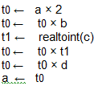
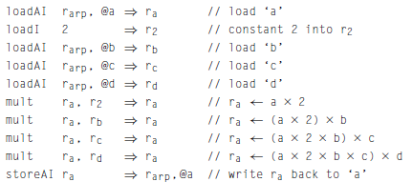
Optimized Intermediate Code w/ Symbolic registers
Code Optimizer
Target ILOCcode w / Virtual Registers
Instruction Selection
Even Semester 2017-18
Nalinadevi Kadiresan

Slide 18
1. loadAI and storeAI takes 3 cycles
2. mult takes 2 cycles
3. Other instructions take 1 cycle
4. The machine has only 3 registers (r1, r2 and r3).
Even Semester 2017-18
Nalinadevi Kadiresan

Slide 19
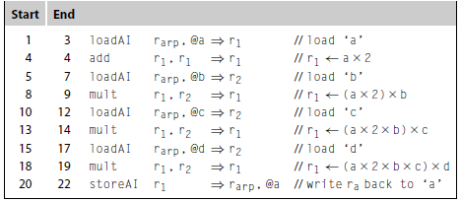
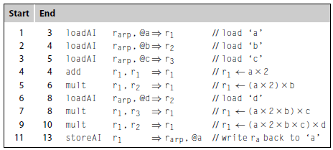
Target ILOC code w / Permanent Registers
Register Allocation
Optimized Target ILOC code w / Permanent Registers
Instruction Scheduling
Even Semester 2017-18
Nalinadevi Kadiresan

Slide 20
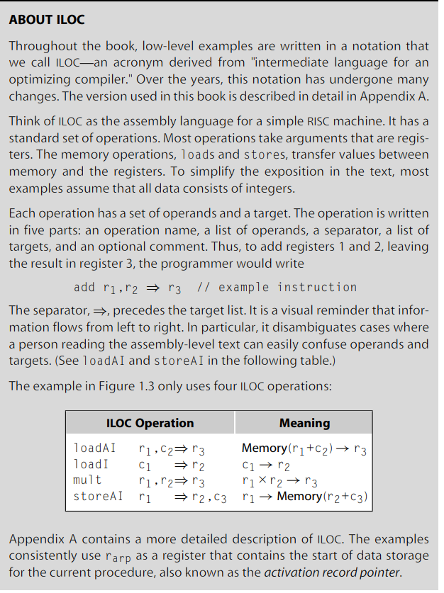
Even Semester 2017-18
Nalinadevi Kadiresan

